Slide 1
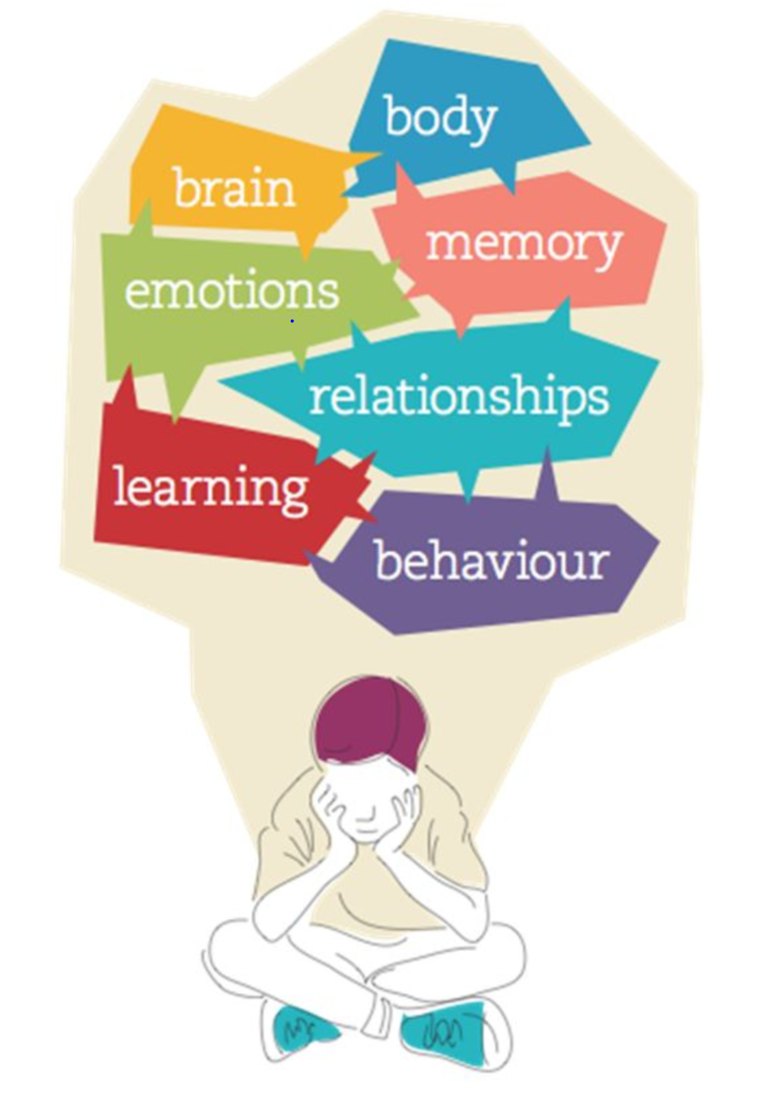

Parent Learning at
One Degree Academy

Slide 2
Children who have developed repeating maladaptive behaviours cannot plan, organise, anticipate and structure actions, limiting their ability to adopt a stance compatible with learning
The challenge for teachers and parents

Slide 3
What can we learn together?
The challenge for teachers and parents

Slide 4

How I can help my child at One Degree Academy
parent learning
Learn about the latest research on child development and wellbeing
family learning
Apply new learning by coaching children in life skills
classroom coaching
home learning
Developing confidence in life skills at home
Observe children in class, build confidence for learning success

Slide 5

What do we focus on for a superhighway to learning ?
Executive functions are the mental processes that enable us to plan, focus, and juggle multiple tasks successfully. We can distinguish between three components: 1. Working memory , 2. Inhibitory control and 3. Cognitive flexibility.
Learn more about Executive Function skills here
Executive Function: Brain's Control Center
https://youtu.be/sZmElSGKBG8

Slide 6

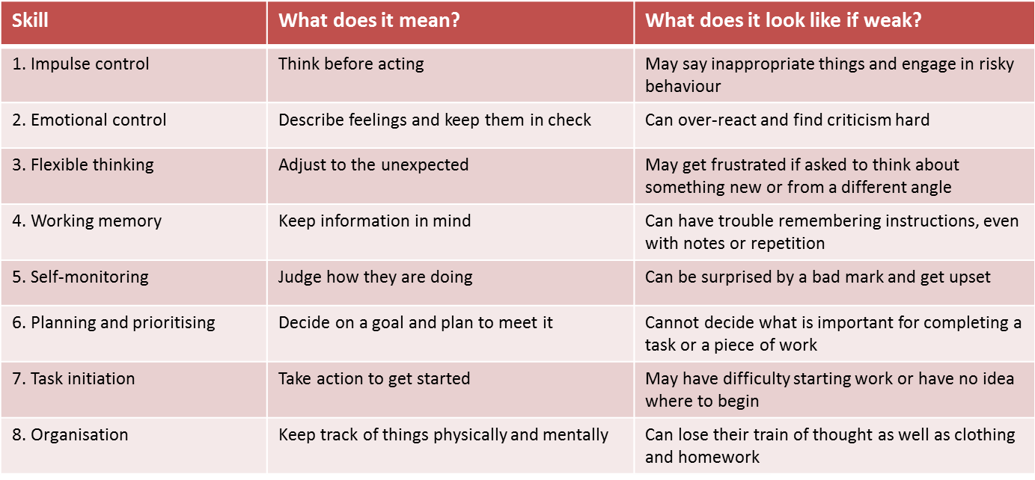
Key executive function skills for learning and mental wellbeing

Slide 7
Coaching and observing in the classroom
Outputs -scholarship
Key stage 1( 5-7) year olds: taxonomy I can track the person who is talking I listen with my eyes, ears and with my voice off I keep my body so that it shows focus- I show “star sitting” at my desk or on the carpet I get into my work and can focus on the task- I don’t distract my classmates- I consistently make eye contact I regularly raise my hand in class and show excitement for learning I am kind and supportive of classmates I use a quiet voice in the classroom when I am supposed to be quiet | I can walk in a straight line with my class and don’t disrupt others in the line I can stay on task for x minutes I show everyone respect with my tone I show everyone respect with my body language I don’t give up even when things are hard I can be trusted to follow adult instructions even when they are not looking I respect other people’s items, I do not touch them unless I have permission I can explain my feelings in a calm manner I can use a kind voice and kind words I keep my belongings tidy.

Slide 8
Developing life skills- mindset
Looking Smart is Most Important
Learning is Most Important
Effort is Negative
Effort is positive
Helpless
Resilient

Slide 9

What can we do?
The challenge for teachers and parents

Slide 10


Children with executive functioning skill challenges may suffer from impulse control difficulties.
Ways to Teach Children Impulse Control
Teach Your Child to Label Feelings. ...
Ask Your Child to Repeat the Instructions. ...
Teach Problem-Solving Skills. ...
Teach Anger Management Skills. ...
Establish Household Rules. ...
Provide Structure and Be Consistent. ...
Practice Delayed Gratification. ...
Be a Good Role Model.

Slide 11


Home learning and growth mindset

