Slide 1
Engaging parents for improving SEMH outcomes
A superhighway to scholarship

Slide 2
The most vulnerable pupils.
Three quarters of parents of children with a mental health problem seek help
One quarter of children get help
35 pupils excluded a day, and rising
4 x more likely:
born in poverty
7x more likely: special educational need
1 in 2 excluded pupils with a recognised social, emotional and mental health need (SEMH)
2 x more likely:
be in care
Kiran@The-Difference.com

Slide 3
Tragic long term outcomes
99% of excluded pupils leave without 5 good GCSEs including English and maths.
I in 2 excluded pupils immediately NEET after GCSEs.
85% of children in criminal justice system were excluded
1%
Lifetime cost to the state:
£370,000 per pupil
£2.1bn officially excluded
£20bn+ unofficially excluded
Age 20, majority of excluded pupils still have no qualifications – Youth Cohort Study (DfE, 2011)
Heightened risk: long-tem unemployment, serious mental ill health (Public Health England, 2014)
Prisoners who were excluded more likely to be repeat offenders – (MoJ, 2015)
Kiran@The-Difference.com

Slide 4
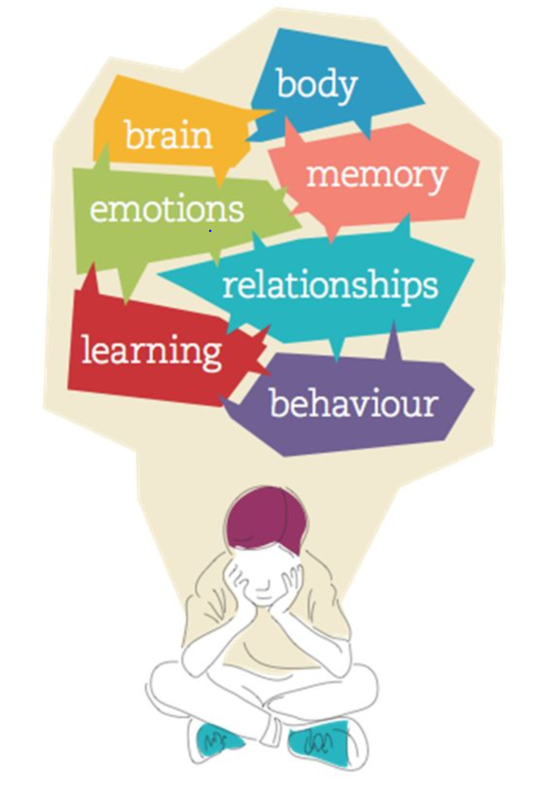

Slide 5
Capacity to learn and achieve is fostered in early years. Confidence and the security a pupil feels depend on implicit awareness of being kept in mind by a significant adult.
Notes:
Epistemic trust – learned trust – blueprint for trust which is learned in primary attachment with caregiver and is transferred to other adults etc

Slide 6
Film example

Slide 7
Parental Engagement
“Parental engagement has a large and positive impact on children’s learning. This was the single most important finding from the authorative review by DFE Review of best Practice in parental engagement Research Report DFE_RR156.
Parents engage well with their child’s learning when they receive clear, specific and targeted information on a regular basis. Involvement of the family and pupil in the creation and monitoring of behavioural goals and learning goals is vital.

Slide 8
Children who have developed repeating maladaptive behaviours cannot plan, organise, anticipate and structure actions, limiting their ability to adopt a stance compatible with learning
The challenge for teachers and parents

Slide 9
This approach enables parents to develop confidence in supporting their child’s development of motivation, resilience, trust, communication, wellbeing, and concentration skills; skills that are vital for learning and thriving. By rehearsing the activities in a low-pressure, supportive environment, the child is sensitised to the skills and is then prompted through post-activity discussion with parents and teachers to apply those skills to other areas of life.

Slide 10
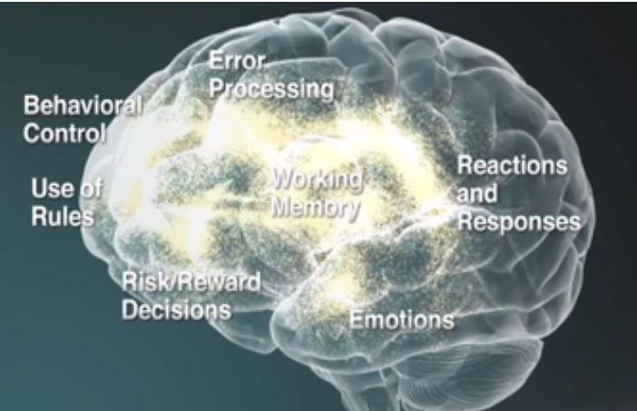
Executive functions definition for staff training
Executive functions are a set of cognitive processes that are necessary for the cognitive control of behavior: selecting and successfully monitoring behaviors that facilitate the attainment of chosen goals.
When children have opportunities to develop executive function and self-regulation skills, individuals and society experience lifelong benefits. These skills are crucial for learning and development. They also enable positive behavior and allow us to make healthy choices for ourselves and our families

Slide 11
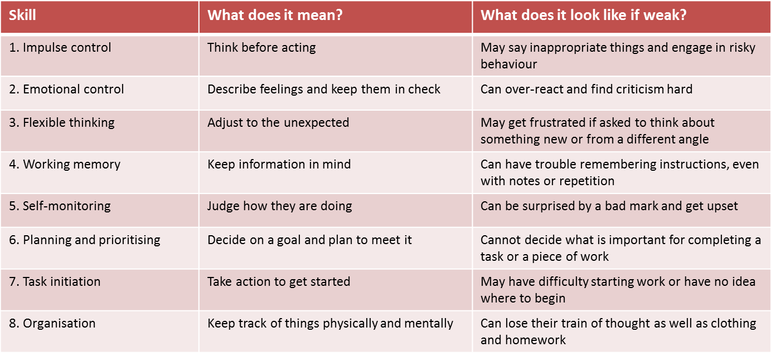
Key executive function Skills for learning and mental wellbeing

Slide 12
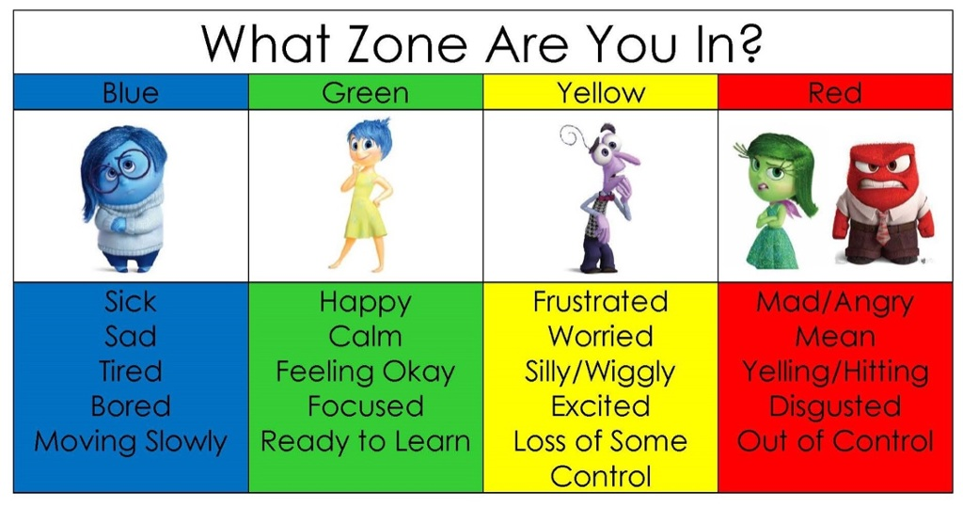
Zones of Regulation

Slide 13
Termly structure
Family partnerships for improving SEMH outcomes for pupils in ODA

Slide 14
Week 1 AM - Parent Learning - Brenda and Neil | Where | Time
New learning introduced, exemplified and discussed by parents (organised by by half term theme) | Library | 1 hour
Parents observe their children in class with tracking guide focussing on the new learning 1 adult per group (possibly 3 groups) | Classrooms | 15 mins
Return to group - discuss observations and findings. B and N allocate action step to each parent. Action steps to be highest leverage thing for each child within that week’s domain of learning. Action step to be small, measurable and achievable in 1 week Parent writes down action step in coaching book | LIbrary | 15 mins
Parent practises action step with partner Parents use feedback cheat sheet to offer feedback to partner: ‘it was effective when you’… / ‘next time try…’ Parents practise action step again in line with feedback and note down / script language they will use at home Parents agree to practise action step at home with child |  | 30 mins
Week 1 PM - Surgery, Supervision, Staff training - Brenda and Neil | Where | Time
Parent surgery drop in as required / according to need - psychotherapeutic support Classroom observation as required by ODA: individual cases or whole class observation Supervision for staff | Library | PM
Staff training on this week’s learning Tracking allocated to teachers to track week’s learning | Library | 4:00

Slide 15
Week 2 AM - Family Learning - ODA staff
Before session: Tracking grid / Feedback from teachers returned (by Wed PM) with any notes about how each child is doing- pen portrait returned to ODA lead staff member
Settling In, coffee and catch up
Workshop on practical parenting theme separate from SEMH: e.g e-safety, money matters, holidays etc Input by ODA / external expert Parents feedback own ideas and support each other with answers or ideas on particular issues / challenges within week’s theme
Parents feedback on progress on action step from last week ODA feeds back on progress on action step from last week Celebrate and next steps
Parent re-articulates action step and identifies what they want to track in the family learning session with their child. Re-frame and adapt action step if needed /completed Each parent’s action step written up on flipchart
Family learning begins - children come in and take part in activity: snakes and ladders, fit lights, group game ODA staff and other parents live coach during session if relevant
Debrief and next steps Parents reflect on progress made and commit to practising at home

Slide 16
Innovation and collaboration

Slide 17
Coaching parents to observe and assess
Outputs -scholarship
Key stage 1( 5-7) year olds: taxonomy I can track the person who is talking I listen with my eyes, ears and with my voice off I keep my body so that it shows focus- I show “star sitting” at my desk or on the carpet I get into my work and can focus on the task- I don’t distract my classmates- I consistently make eye contact I regularly raise my hand in class and show excitement for learning I am kind and supportive of classmates I use a quiet voice in the classroom when I am supposed to be quiet | I can walk in a straight line with my class and don’t disrupt others in the line I can stay on task for x minutes I show everyone respect with my tone I show everyone respect with my body language I don’t give up even when things are hard I can be trusted to follow adult instructions even when they are not looking I respect other people’s items, I do not touch them unless I have permission I can explain my feelings in a calm manner I can use a kind voice and kind words I keep my belongings tidy.

Slide 18
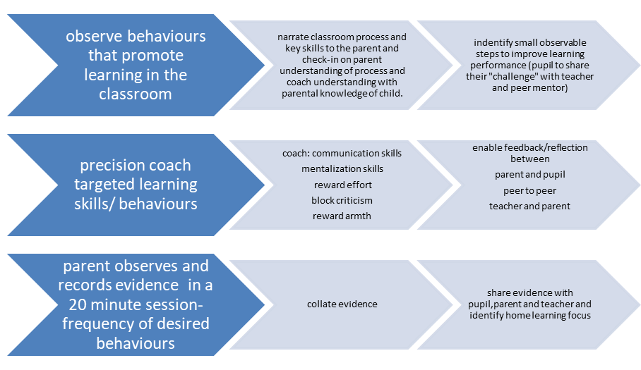

Slide 19
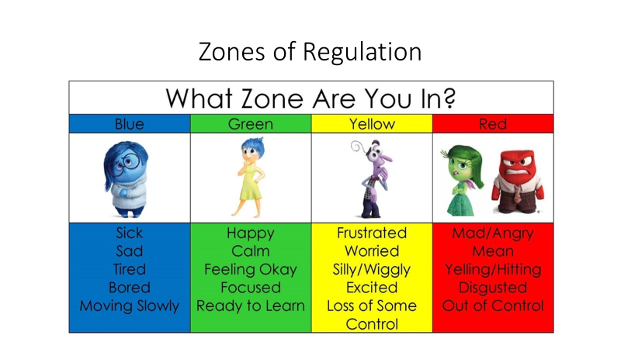
home learning
Social ecology development
Personalised skills homework

Slide 20
Guiding principle-Daily record to be sent to parent for home learning to support the family coaching. Implementation plan for discussion.
Managing self with adults
One scholarship/executive function behaviour
/5
Managing self with pupils
Managing self with learning

